Slide 1
Algorithms and Data Structures (CIS1002-N)
Week 6: Singly- ,Circular- and Doubly-Linked Lists
More Examples and Consolidation
Module Leader: Dr Annalisa Occhipinti
Email: A.Occhipinti@tees.ac.uk

Slide 2
A few notes…
ICA pack – programming tasks also available on BB
If you missed any of the last lessons, make sure you watch the recording!
Lab Sessions recordings available under Lab Session Solutions, for each week

Slide 3
Homework:
Inserting a node in an ordered singly linked list.
public void insert(int entry)
To insert an item:
Find the place where the new item is supposed to go,
Insert the item in the list.
3 Cases to consider:
Case 1: the list is initially empty.
Case 2: the new item is smaller than the smallest item in the list.
Case 3: the item is to be inserted within the list.

Slide 4
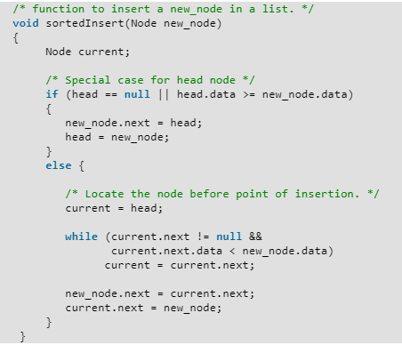
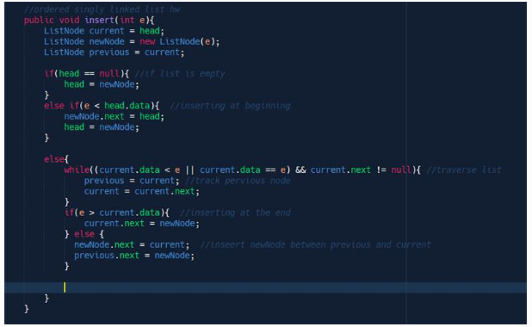
Adapt to int entry as parameter

Slide 5
Schedule
Week | Lecture (1hour) – Lab Session (2hours)
Week 1 | Introduction to Algorithms and related Data-Structures – Array ADT
Week 2 | Sorting : Bubble sort, Cocktail Shaker sort | ICA Briefing
Week 3 | Sorting : Selection sort and Insertion sort
Week 4 | Singular Linked-lists | ICA Briefing – Programming Tasks
Week 5 | Ordered Linked-Lists, Circular Linked-lists
Week 6 | Doubly Linked-lists and Consolidation
Week 7 | Stacks
Week 8 | Queues
Week 9 | Recursion
Week 10 | Recursion
Week 11 | Trees and balanced trees
Week 12 | Merge Sort and Quick Sort
Note: The schedule may be adjusted based on class progress.

Slide 6
A quick recap…
How many different types of linked-list do you know?
head
1500
1532
1564
1596
1628
1500
10
1532
12
1564
12
1596
32
1628
64
Dummy-node
null
A
B
C
null
X
A
B
C
Head

Slide 7
Circular Linked Lists - Implementation
Dummy-node
X
A
B
C
Head

Slide 8
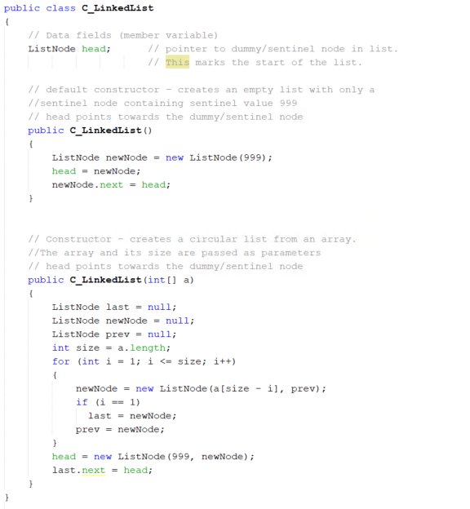
Implementation

Slide 9
Circular linked-list – 6 Quick Questions
How would you implement the following methods?
1) Determine whether the list is empty or not. Boolean isEmpty() | 2) Retrieve the first element of the list, return -1 if the list is empty. | 3) Delete the last item in the list. Return true if successful, false if the list is empty
4) Retrieve the last element of the list, return -1 if the list is empty. | 5) void addLast(int value) Add an element at the end of the list. | 6) searchPointer(int obj) look for the node containing obj and return the index of the node (starting from 1). Return 999 if the element is not found.
Dummy-node
Extension: deleteAtPosition(index)
addAtPosition(index, obj)
countEvenNodes()
X
A
B
C
Head

Slide 10
Doubly Linked Lists
null
A
B
C
null
Head

Slide 11
Variations of Linked-Lists
Doubly linked-lists
Each node points to not only its successor but also its predecessor
There are two null: at the first and last nodes
Advantage: given a node, it is easy to visit its predecessor.
Sometimes convenient to traverse lists backwards
null
A
B
C
null
Head

Slide 12
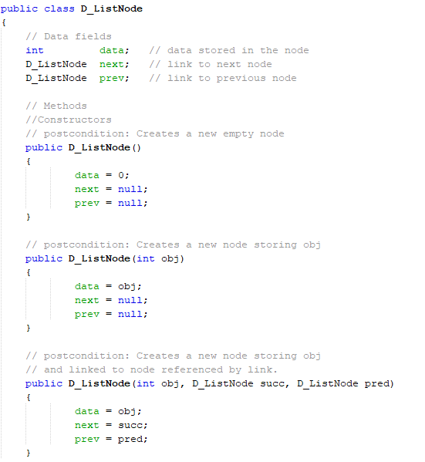
Constructors – DoublyLinkedListNode

Slide 13
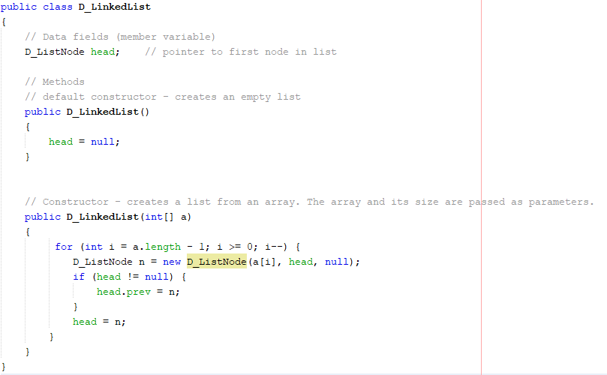

Slide 14
Inserting a new node in a Doubly Linked List
(At least) four possible cases:
Insert into an empty list
Insert in front
Insert at back
Insert in middle

Slide 15
Inserting
The insertion of a node in the list requires the adjustment of 2 reference-variables/pointers either side.
Case 1: the list is empty
Case 2: insertion at the beginning of a non-empty list
Case 3: insertion at the end of a non-empty list
Case 4: insertion somewhere in a non-empty list

Slide 16
Inserting a new node at a specified position
Inserting a new node at a specified position/index :
boolean insertAtIndex(int index, int value)
Inserting a node after a node storing a given value :
int insertAfterValue(int value, int searchvalue)
… and returning the node’s position

Slide 17
Inserting a new node at a specified position
boolean insertAtIndex(int index, int value)
Specify index where new node with value is to be inserted (1-index based system).
boolean type, so return value will either be true or false.
Try to locate index^{th} node: if found, mark current node.
If index invalid or not found before reaching end of list, return false.
Create a new node.
if index is 1, insert as first element.
Otherwise, insert after marked node.

Slide 18
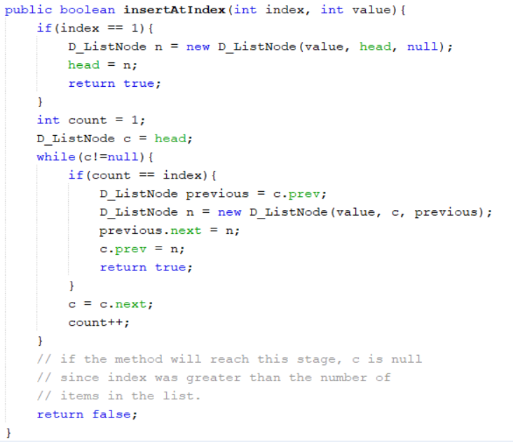

Slide 19
Homework: Write the Java code for the method below Inserting a node after a node storing a given value
int insertAfterValue(int value, int searchvalue)
Specify searchValue after which new node with value is to be inserted.
int type, so return value will be position of new node in list.
Search for the first node containing searchvalue, keeping a count of its position in the list.
May reach end of list and not find searchvalue,then return sentinel value (-1).
Create new node.
Insert and return position in list.

Slide 20
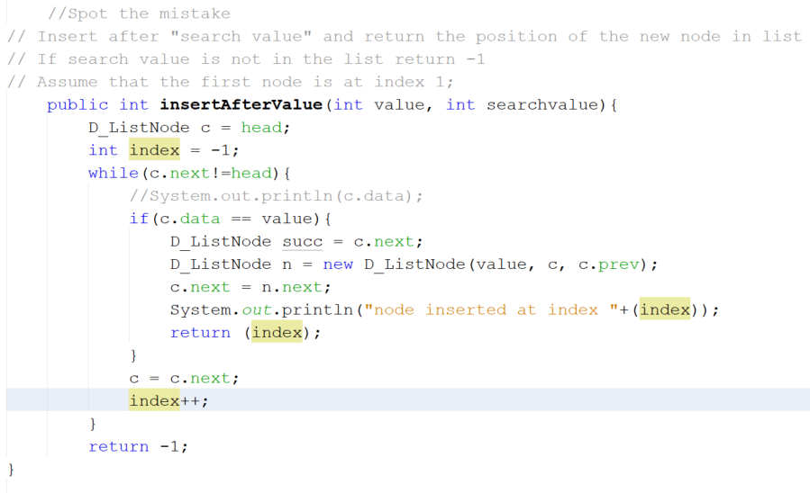
Spot the Mistakes
Notes:
//Spot the mistake
// Insert after "search value" and return the position of the new node in list
// If search value is not in the list return -1
// Assume that the first node is at index 1;
public int insertAfterValue(int value, int searchvalue){
D_ListNode c = head;
int index = -1;
while(c.next!=head){
//System.out.println(c.data);
if(c.data == value){
D_ListNode succ = c.next;
D_ListNode n = new D_ListNode(value, c, c.prev);
c.next = n.next;
System.out.println("node inserted at index "+(index));
return (index);
}
c = c.next;
index++;
}
return -1;
}

Slide 21
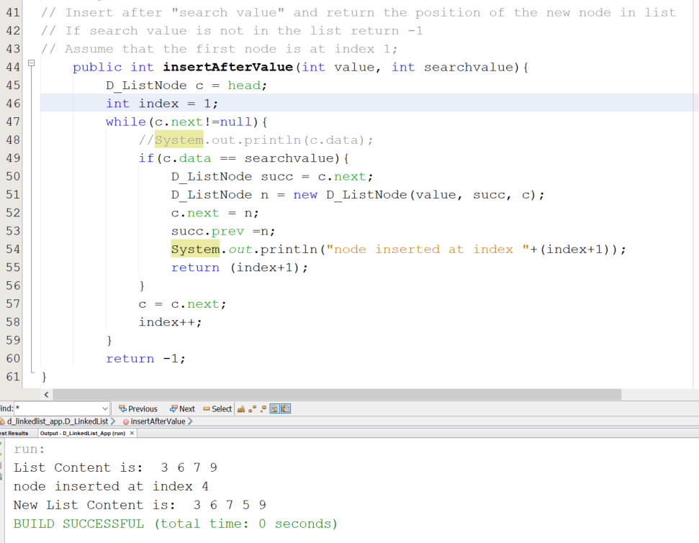
Answer
Don’t forget to check if this still works when the list is empty or if you want to add the element at the end of the list

Slide 22
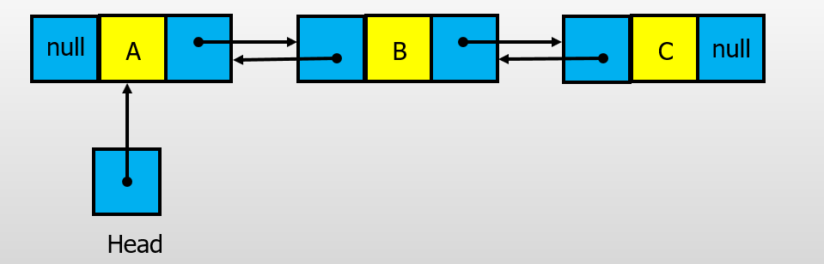
Doubly linked-list – 6 Quick Questions
How would you implement the following methods?
1) Determine whether the list is empty or not. Boolean isEmpty() | 2) Retrieve the first element of the list, return -1 if the list is empty. | 3) Delete the last item in the list. Return true if successful, false if the list is empty
4) Retrieve the last element of the list, return -1 if the list is empty. | 5) void addLast(int value) Add an element at the end of the list. | 6) searchPointer(int obj) look for the node containing obj and return the index of the node (starting from 1). Return 999 if the element is not found.
Extension: deleteAtPosition(index)
addAtPosition(index, obj)
countEvenNodes()

Slide 23
And…that’s it about Lists!
SinglyLinkedLists
DoublyLinkedLists
CircularLinkedLists
You can now start working on the ICA, make sure you start now while they are fresh in your mind!
From next lesson, we are starting a new topic.
If you did last week’s lab, you have already implemented a few of the methods for the Singly Linked Lists.
Make sure you attend all the labs sessions.

Slide 24
Quiz – Week 6

Slide 25
Homework Question
Implement the following method for a circular-linked list
int deleteAllNodesWithValue(int searchValue)
Description:
Delete all the nodes containing searchValue, if it exists. Return the numbers of node deleted.

Slide 26
Doubly Linked Lists VS Singly Linked Lists
Pros of DLL | Cons of DLL
Easier to insert elements: We can always access both the previous and the next elements to perform reference-variable/pointer re-assignment. | Memory usage: Extra overhead per element (extra reference-variable/pointer) when compared to a singly linked-list.
Easier to delete elements: Stepping through a singly linked-list and removing elements, you have to keep track of the previous element. | Complex Implementation: The node contains some data and a pointer to the next as well as the previous node in the list
Time Complexity: In case of doubly linked list the complexity of insertion and deletion at a known position is O(1), compared to O(n) in Singly Linked List. | Time Complexity: However, more pointer operations are required than in a singly linked list.

